Slide 1
Hosting your project at the
Academy Software Foundation

Slide 2
Antitrust Policy Notice
Linux Foundation meetings involve participation by industry competitors, and it is the intention of the Linux Foundation to conduct all of its activities in accordance with applicable antitrust and competition laws. It is therefore extremely important that attendees adhere to meeting agendas, and be aware of, and not participate in, any activities that are prohibited under applicable US state, federal or foreign antitrust and competition laws.
Examples of types of actions that are prohibited at Linux Foundation meetings and in connection with Linux Foundation activities are described in the Linux Foundation Antitrust Policy available at www.linuxfoundation.org/antitrust-policy. If you have questions about these matters, please contact your company counsel, or if you are a member of the Linux Foundation, feel free to contact Andrew Updegrove of the firm of Gesmer Updegrove LLP, which provides legal counsel to the Linux Foundation.

Slide 3


An Open Source Foundation Developed in Partnership
The Academy Software Foundation provides a neutral forum for open source software developers in the motion picture and broader media industries to share resources and collaborate on technologies for image creation, visual effects, animation and sound.
Notes:
The Academy Software Foundation was developed in a partnership between the Academy of Motion Picture Arts and Sciences and the Linux Foundation, both partners bringing a unique blend of film industry knowledge and open source technical and organizational expertise to create a unique organization dedicated to accelerate software development and innovation in the motion picture industry.

Slide 4

Why the Academy Software Foundation?
Legal Framework
Continuous Integration and Build Infrastructure
Clear path to accepting contributions (neutral forum)
Versionitis
Notes:
These were some of the problems that the Foundation set out to solve.

Slide 5

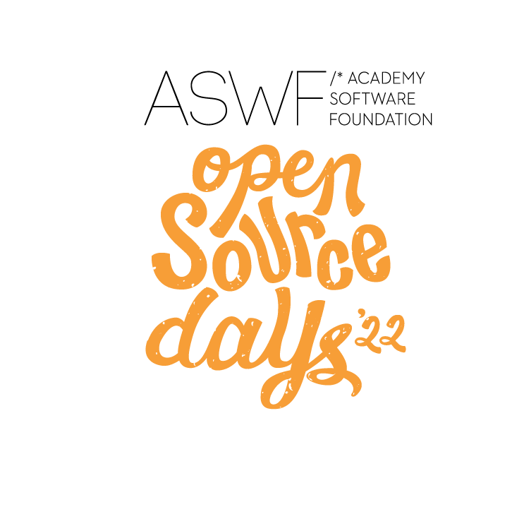

ASWF created
01
Open Source Days 2021
Open Source Day 2019
Open Source Days 2020
Open Source Forum
August 10, 2018
Founding members:
Animal Logic
Autodesk
Blue Sky Studios
Cisco
DNEG
DreamWorks Animation
Epic Games
Foundry
Google Cloud
Intel
SideFX
The Walt Disney Studios
Weta Digital
First project
March 10,2022
Rez
DPEL
RawtoACES
August 4-5, 2021
MaterialX
Maxon
Open Source Days 2022
July 29, 2019
OpenTimelineIO
Netflix
Amazon Web Services
Rodeo FX
MovieLabs
August 19-20, 2020
Unity Technologies
Conductor Technologies
SMPTE
October 23,2018
OpenVDB
New members:
Sony Pictures Entertainment
Warner Bros.
Blender Foundation
Visual Effects Society
12
August 8-9, 2022
OpenFX
OpenAssetIO
Open Review Initiative
Canonical
Khronos Group
10
April 16, 2020
Open Shading
Language
AMD
DockYard
September 13, 2019
Apple
Microsoft
08
05
December 15,
2020
Adobe
ETC
January 28,
2022
Wevr
02
February 8, 2019
OpenColorIO
06
13
03
May 1, 2019
OpenEXR
OpenCue
NVIDIA
ftrack
Red Hat
07
09
11
Scitech
Council
Open source
Investigation
concludes
04
COVID
19
$1M/year
May
August
Nov
Feb
May
August
Nov
Feb
May
August
Nov
Feb
Nov
Feb
May
August
2018
2019
2020
2021
2022
Notes:
The Academy Software Foundation timeline of notable events since its creation 3 years ago.

Slide 6
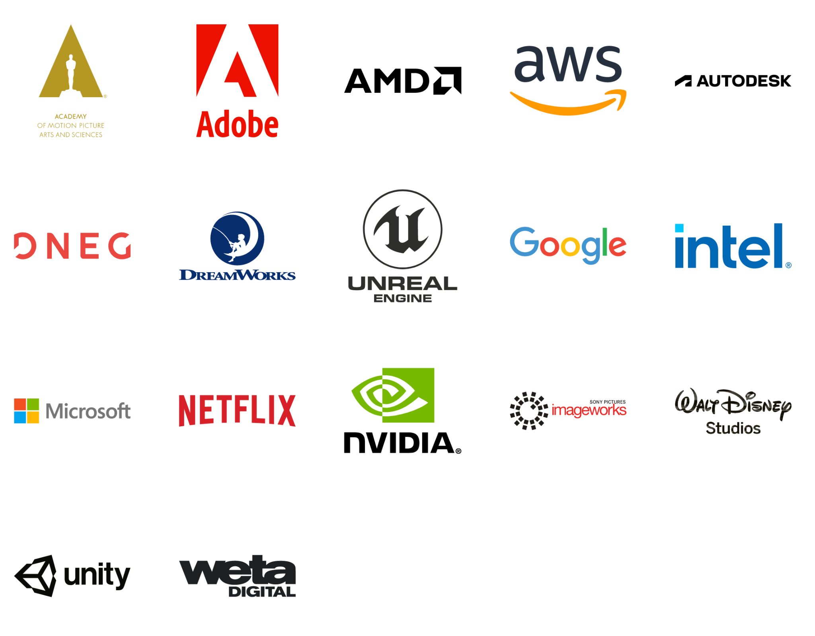
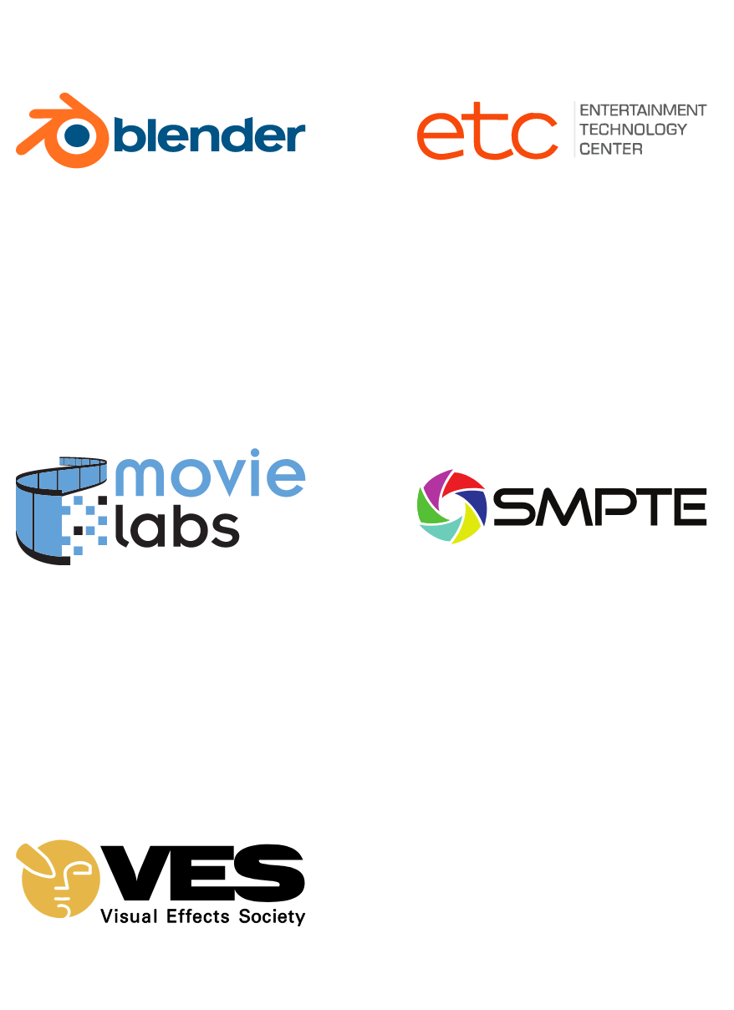
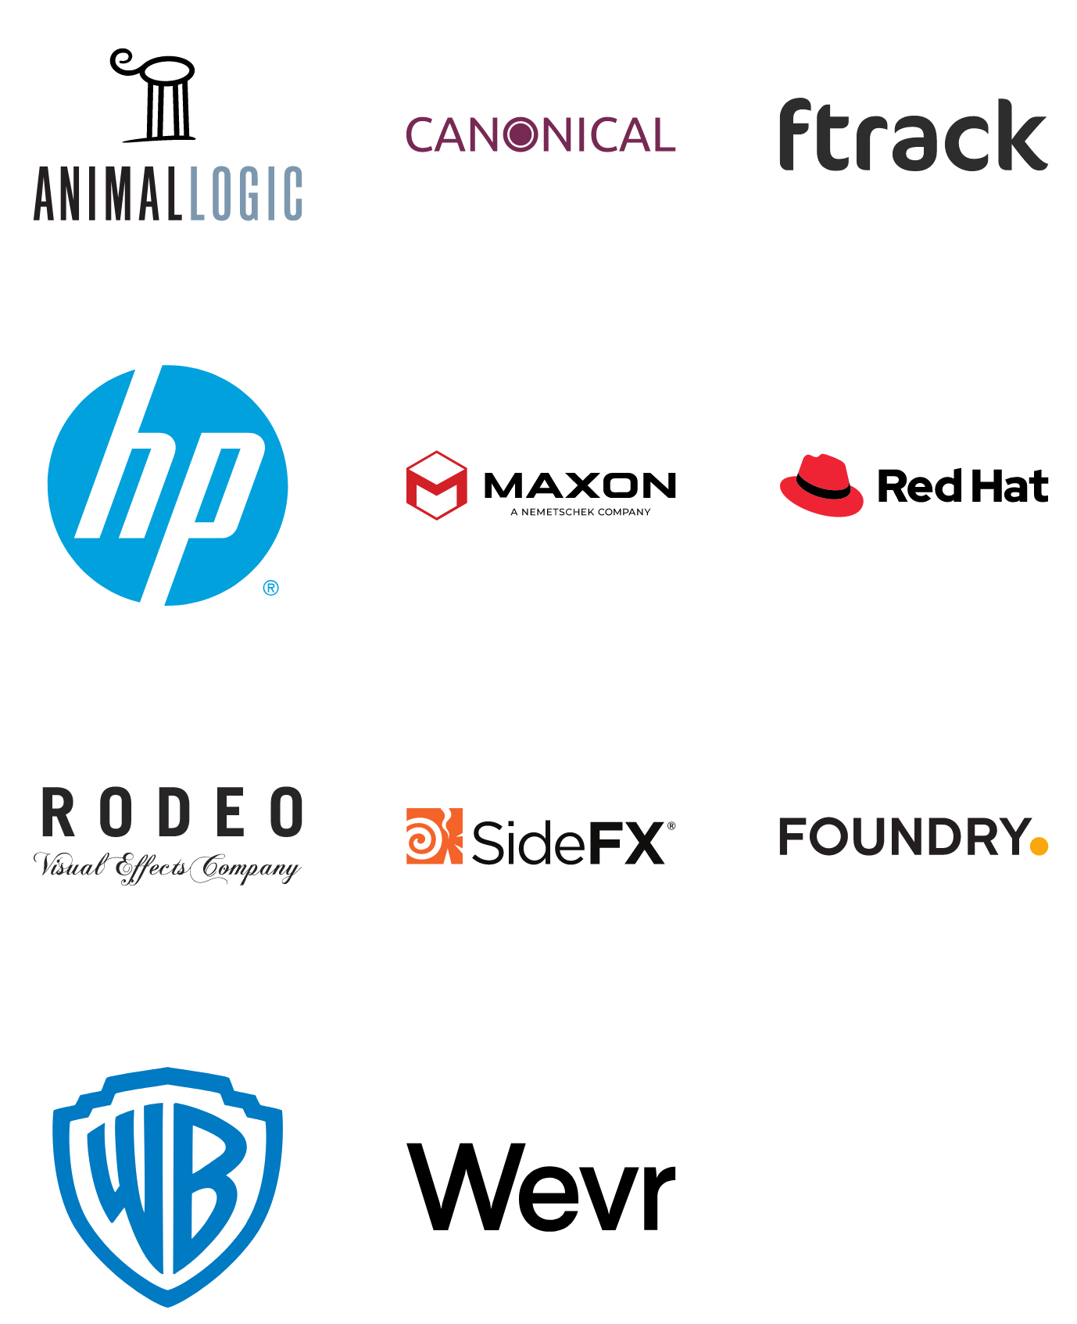

Membership
Premier
General
Associate
Notes:
34 companies

Slide 7
Our Mission
Increase the quality and quantity of open source contributions by establishing a governance model, a legal framework and a community infrastructure that lowers the barrier to entry for developing and using open source software.

Slide 8
Our Goals
Provide a neutral forum to coordinate cross-project efforts, establish best practices and share resources.
Develop an open continuous integration (CI) and build infrastructure to enable reference builds from the community.
Streamline development for build and runtime environments through the sharing of open source build configurations, scripts and recipes.
Provide individuals and organizations with a clear path for participation and code contribution.
Provide better, more consistent licensing through a shared licensing template.
Create working groups for exploration of new or larger projects.
Focus on diversity and inclusion and raising the profile of software engineers in our industry.

Slide 9












Our Projects
contributed by:
Dreamworks Animation
contributed by:
Google Cloud and
Sony Pictures Imageworks
contributed by:
The Academy of Motion Picture Arts and Sciences
contributed by:
Sony Pictures Imageworks
contributed by:
Lucasfilm
contributed by:
Pixar Animation Studios
contributed by:
Sony Pictures Imageworks
contributed by:
Lucasfilm
contributed by:
Academy Software Foundation
created by:
Academy Software Foundation
Open
Review
Initiative
contributed by:
Open Effects Association
contributed by:
Foundry
created by:
Academy Software Foundation

Slide 10
Diversity & Inclusion
Diversity & Inclusion Working Group
“Open source has the power to break down racial, gender, and corporate barriers to unite people around a shared goal…”
Read more at aswf.io/diversity_inclusion.

Slide 11
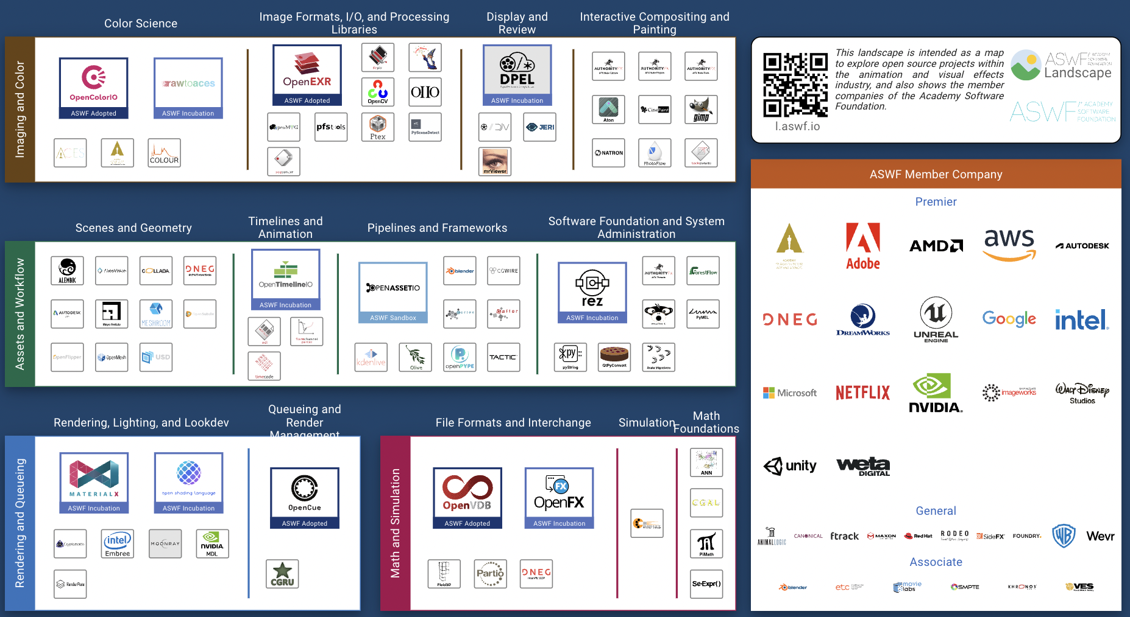
ASWF Landscape
https://l.aswf.io/
Public list of open source projects in the animation and VFX industry
Updates can be submitted via GitHub
Goal is to have all active, open source projects in animation and VFX industries represented.

Slide 12
The Real Question is Which Projects Matter?
Value of of Individual Project
Number of Open Source Projects

Slide 13


The Answer: Projects With Sustainable Ecosystems
PROJECTS
Sustainable projects have a developer community whose technology is used in commercial solutions that profit businesses, who in turn participate and reinvest back into the project and hire developers to work in the community.
DEVELOPER
COMMUNITY
TECHNOLOGY
PARTICIPATION
PRODUCTS
PROFITS
MARKETS
PRODUCTS

Slide 14
Open Source in the motion picture and broader media industries sector challenges
Glass ceiling for project investment and adoption
in the absence of a fair governance and safe haven for the project’s assets
1
Managing projects assets
As project grows, it is unclear who should own legal and administrative tasks that are essential to the health of the project
2
Developed for a specific product needs
The open source spinoff is a result of wanting to build an ecosystem and collaborate on building a platform
3
Governance challenges
No formal governance,
governance favors the creators of the project,
project backer dominating dev and governance
4
Fragmentation
Lack of integration
Lack of cross pollination across projects
5

Slide 15
Creating sustainable open source projects requires real work
Governance and Membership
Incorporation, Tax status, Bylaws, Member Agreements, Antitrust, etc.
Ongoing business development and membership recruitment
Development Process
Technical Decision Making
Project Life Cycle
Release Process
Infrastructure
Custom infrastructure using open source best practices
Security and reliability
Ecosystem Development
Marketing
Events
Training
IP Management
Code Provenance and License compliance
Trademark management
Legal defense and Collaboration

Slide 16
What do Academy Software Foundation projects look like?

Slide 17


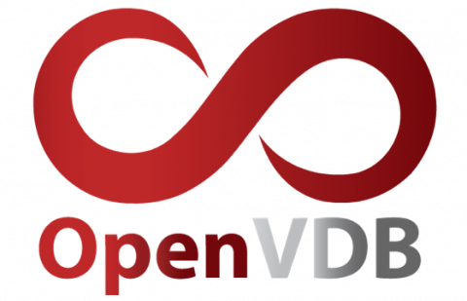
How to Train Your Dragon: The Hidden World; courtesy of DreamWorks Animation
The Croods; courtesy of DreamWorks Animation
First project adopted by ASWF in Sept. 2018; first project to graduate to adopted status in July 2019.
Developed by DreamWorks Animation in 2012.
C++ library for volumetric representations including fluid simulations, animated volumes and environmental effects.
Academy Technical Achievement Award recipient.
Key contributors include DreamWorks, Autodesk, DNEG, Industrial Light & Magic, NVIDIA, SideFX, Weta Digital.
openvdb.org
Notes:
Used on films including Boss Baby, Trolls, The Croods, and How to Train Your Dragon: The Hidden World
Since joining:
Released v6.0, v6.1, v7.0 (above + bug-fixes & optimizations)
New collaborations (Autodesk/Nvidia)

Slide 18
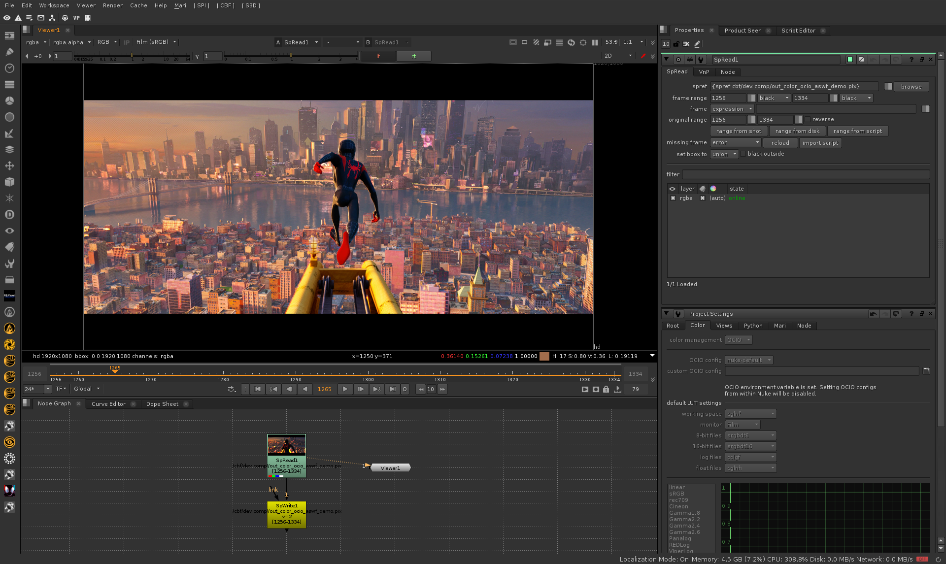

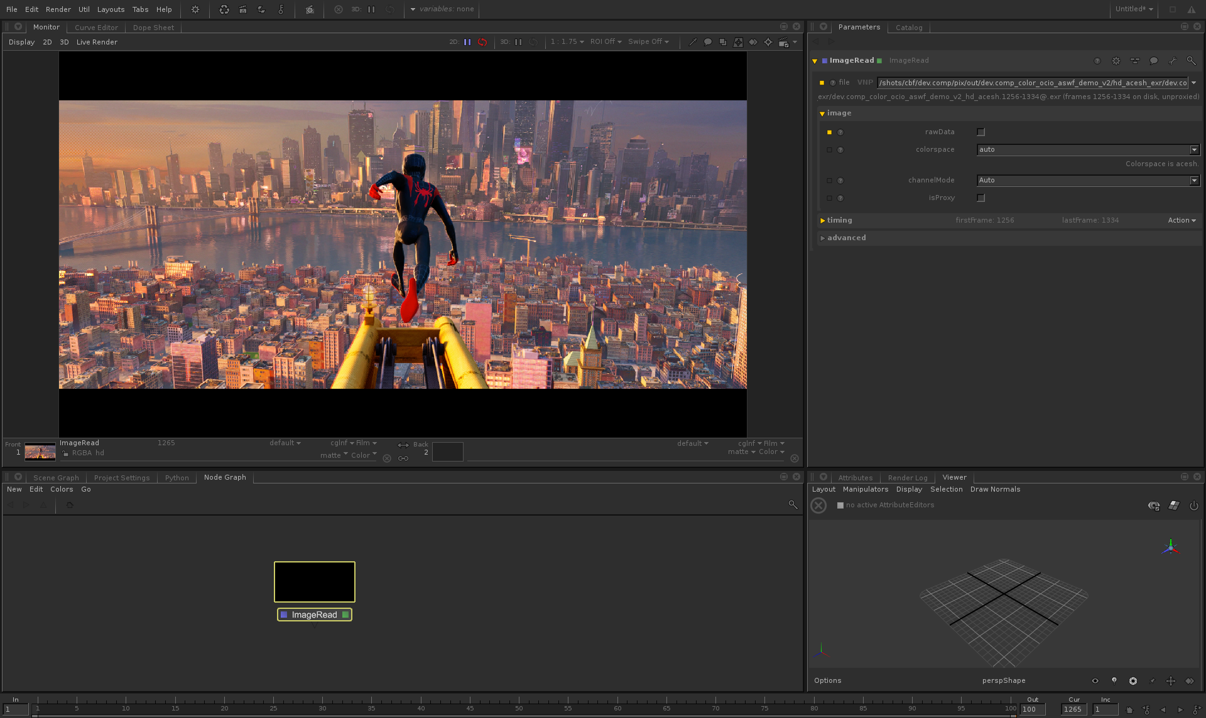
Nuke
Spider-Man™: Into the Spider-Verse; all images courtesy of Imageworks
Joined ASWF in Feb. 2019; adopted status in Nov. 2019.
Developed by Sony Pictures Imageworks in 2003.
Provides a consistent user experience across digital content creation applications; widely adopted in VFX and computer animation studios and software.
Academy Technical Achievement Award recipient.
Key contributors include Imageworks, Autodesk, DNEG, ILM, Foundry, Framestore.
OCIO v2 released fall 2020, led by Autodesk.
Katana
opencolorio.org
Notes:
Top image is in Foundry’s Nuke, bottom in Foundry’s Katana

Slide 19

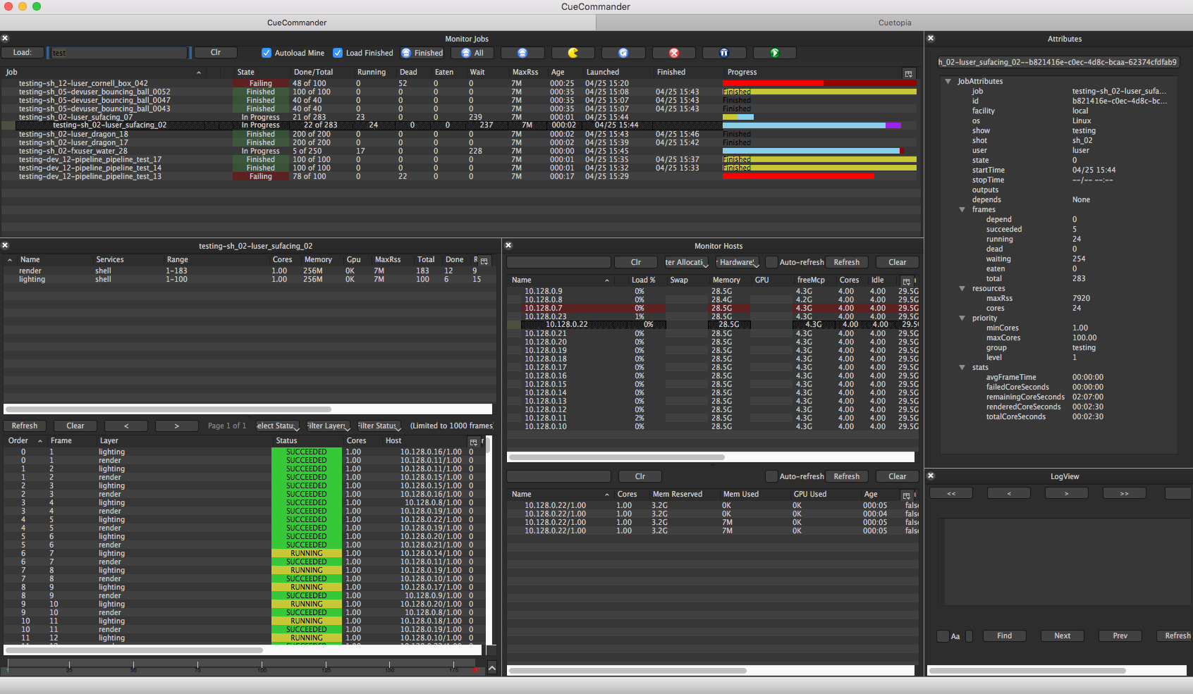
Smurfs: The Lost Village; courtesy of Sony Pictures Imageworks
OpenCue screenshot
Joined ASWF in April 2019.
Developed at Sony Pictures Imageworks as its internal render farm manager (“Cue3”); collaboration with Google Cloud to release as OpenCue in January 2019.
Fully featured render manager for media and entertainment that can be used to break down complex jobs into individual tasks.
Contributors include Imageworks, Google, Netflix, Microsoft, Amazon.
Monthly releases over the past year, including adding Python 3 compatibility, Windows support, new documentation.
opencue.io

Slide 20


Images from Solo: A Star Wars Story. © and TM Lucasfilm Ltd. All Rights Reserved.
Joined ASWF in April 2019; adopted status in Nov. 2019.
Developed by ILM in 1999; first release of a major open source project by a studio.
High dynamic-range (HDR) image file format for high-quality image processing and storage; widely adopted standard in computer graphics.
Academy Technical Achievement Award recipient.
Key contributors include ILM, Disney Animation, Imageworks, Epic Games, Weta Digital, Pixar, Autodesk, and DreamWorks.
OpenEXR 3.0 just released.
openexr.org

Slide 21
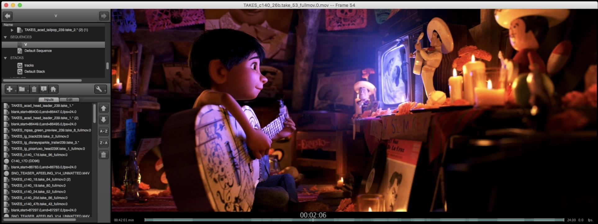
OpenTimelineIO used on Coco for transitions and linking media to the latest renders.
Image courtesy of Pixar Animation Studios.
Joined ASWF in July 2019.
Developed by Pixar Animation Studios.
Open source interchange format for editorial timeline information – clips, timing, tracks, transitions, metadata etc.
Key contributors include Pixar, Netflix, DreamWorks, Autodesk.
In Public Beta
opentimeline.io

Slide 22


The Angry Birds Movie 2; courtesy of Imageworks
Spider-Man: Far From Home; courtesy of Imageworks
Joined ASWF in April 2020.
Developed by Sony Pictures Imageworks; released as open source in 2010.
De facto standard shading language for VFX and animation, ideal for describing materials, lights, displacement, and pattern generation.
Academy Technical Achievement Award recipient.
Key contributors include Imageworks, Animal Logic, NVIDIA, Pixar, DNEG, Autodesk.
openshadinglanguage.org

Slide 23
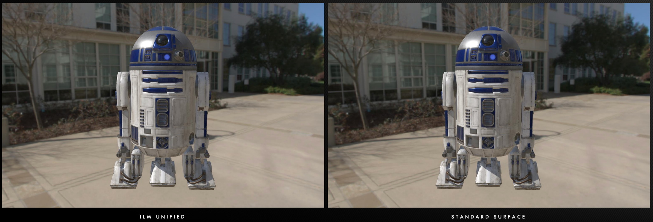
ILM Production tests using MaterialX
Joined ASWF in March 2021.
Open standard for representing rich material and look-development content in computer graphics, enabling its platform-independent description and exchange across applications and renderers.
Launched at Industrial Light & Magic in 2012, MaterialX has been a key technology in their feature films and real-time experiences since Star Wars: The Force Awakens and Millennium Falcon: Smugglers Run.
Key contributors include Sony Pictures Imageworks, Pixar, Autodesk, Adobe, and SideFX.
materialx.org

Slide 24
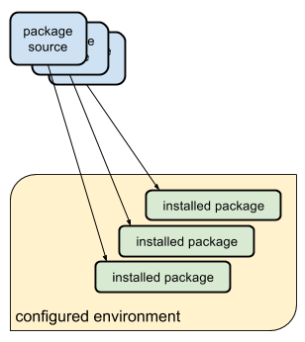
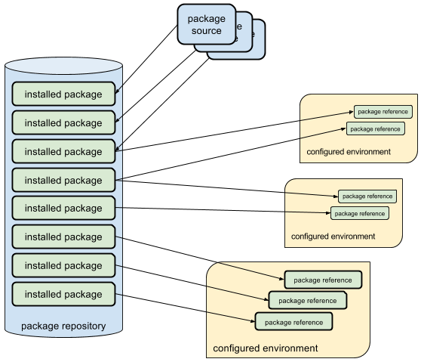

Typical package managers install packages into an environment
Rez installs packages once, and configures environments dynamically
Joined ASWF in February 2022.
Developed by Allan Johns of Method Studios.
Cross-platform package manager that leverages a central repository for storing packages instead of installing into each environment separately, reducing the time to create complex environments to just a few seconds.
Key contributors include Luma Pictures, Method Studios, NVIDIA, and Shotgrid
rez-project.io

Slide 25
New Api
Spectral
Repo
Metadata
Update writing
Lens Functions
HDRI Merging
Bindings
December 2022
Joined ASWF in January 2021.
Software package that converts digital camera raw files to ACES container files containing image data encoded according to the Academy Color Encoding Specification (ACES) as specified in SMPTE 2065-1.
Key contributors include AMPAS and Weta Digital
rawtoaces.org

Slide 26
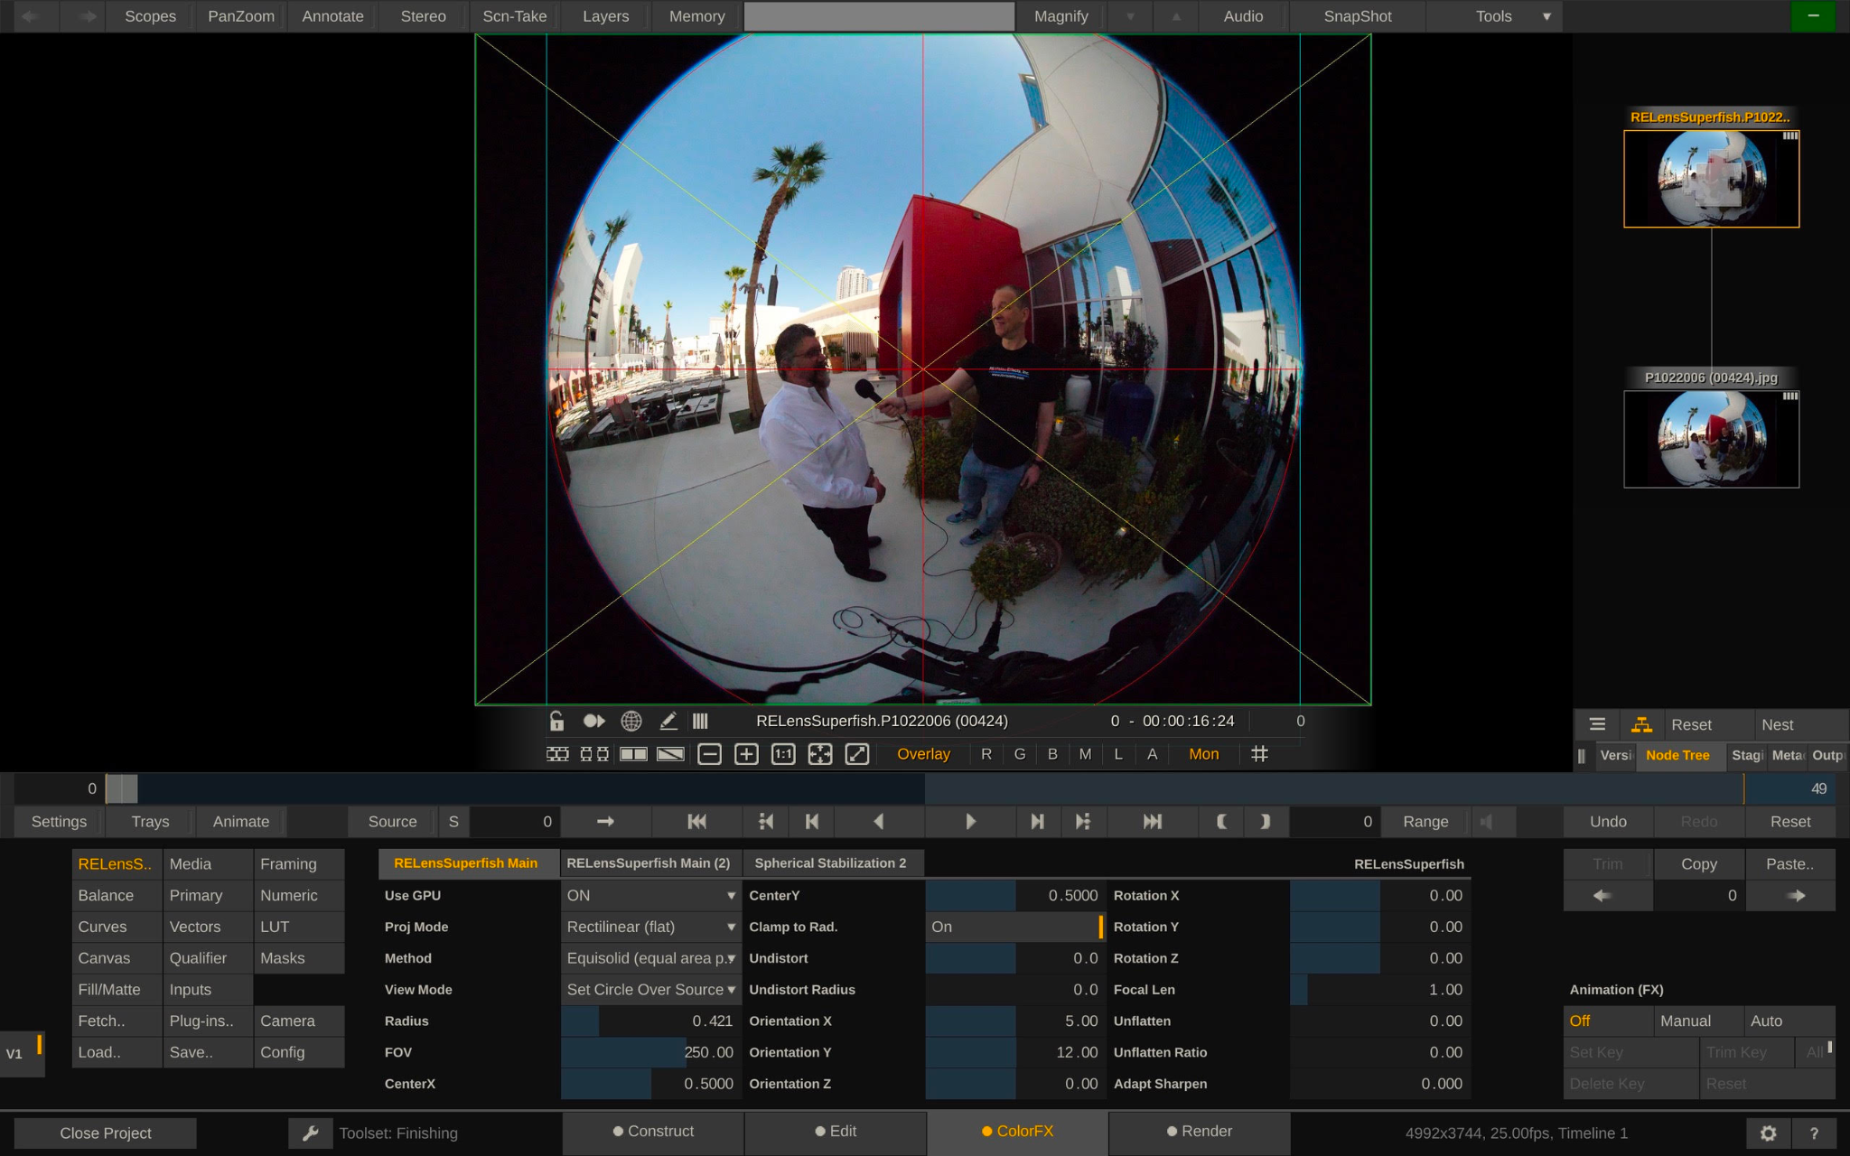
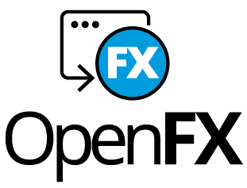
OpenFX Overlay Draw Suite
Industry-wide common interface between image-based visual effects plugins and host applications, used by Autodesk Flame, Foundry Nuke, Blackmagic Design DaVinci Resolve and Fusion, Sony Catalyst and MAGIX Vegas Pro, Assimilate Scratch, Filmlight Baselight, Boris FX Sapphire and Silhouette, RE:Vision Effects and more. Open, extensible C API currently version 1.4 with version 1.5 in development. Want to find out more or contribute?
openeffects.org

Slide 27




Launching with ASC Standard Evaluation Material II (StEM2), Animal Logic’s ALab Phase 2, Intel’s Volumetric Clouds Library and AWS character Noa.
Providing a vendor-neutral hosting platform and a uniform license agreement, to encourage, curate and publish production-grade sample assets for developers, researchers and educators, Digital Production Example Library is the conclusion of an Academy Software Foundation working group on assets
dpel.aswf.io

Slide 28
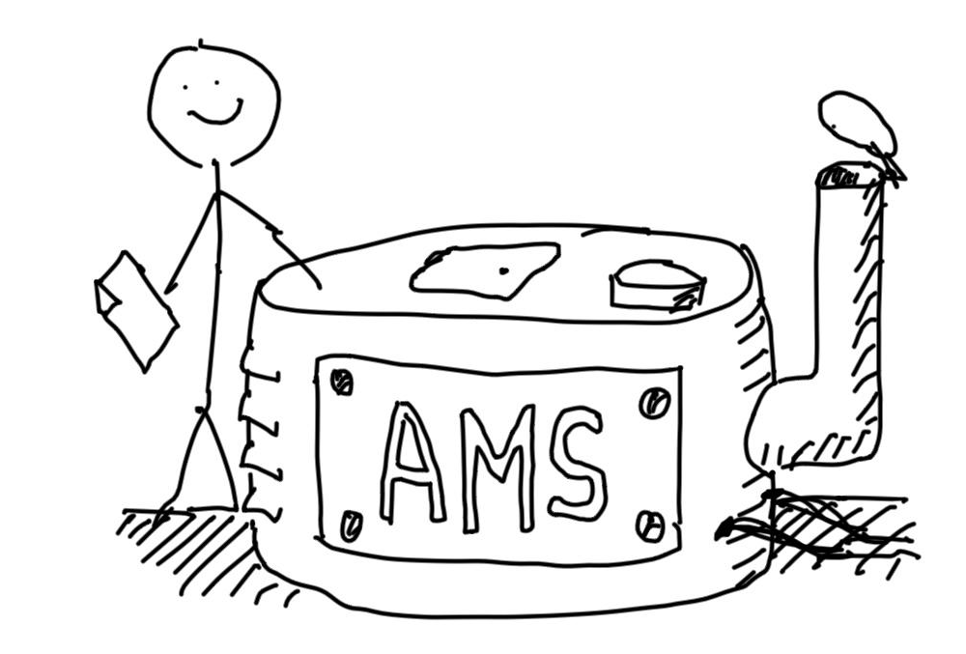





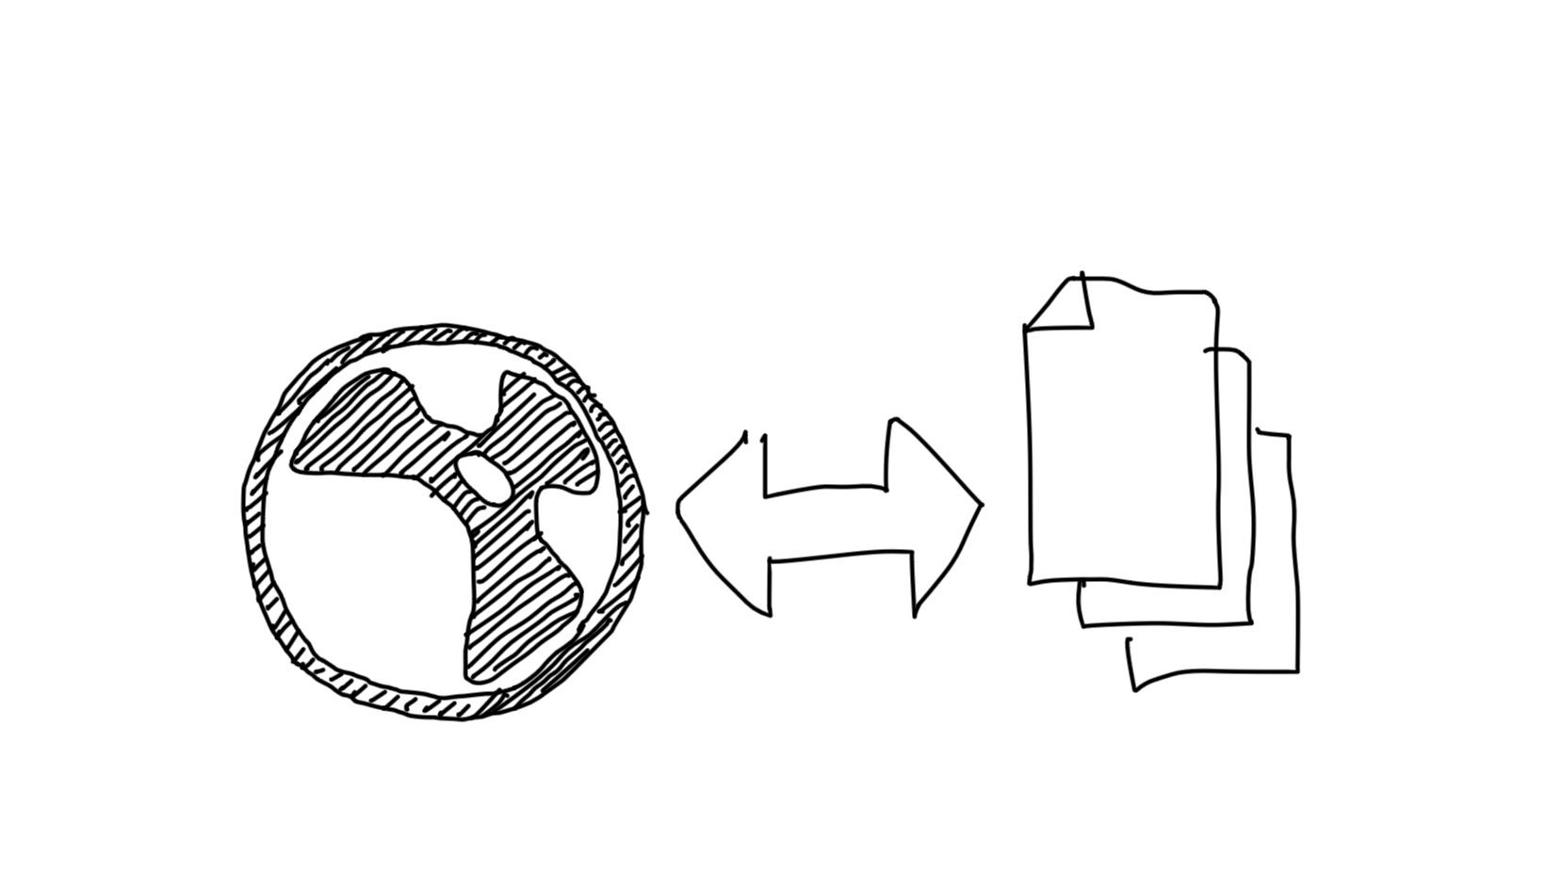





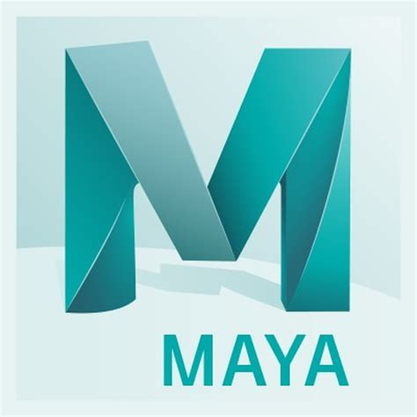

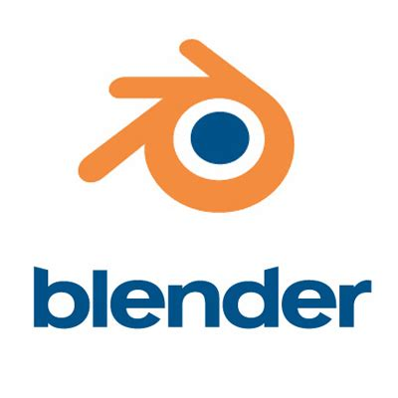

OpenAssetIO is an early stage open source interoperability standard between tools and asset management systems, developed by Foundry with proofs of concept and design input from 15 companies including DNEG, Pixar, Amazon Web Services, Animal Logic, Blizzard, and Blender. OpenAssetIO was the first project to join the Academy Software Foundation in sandbox stage.
openassetio.org

Slide 29
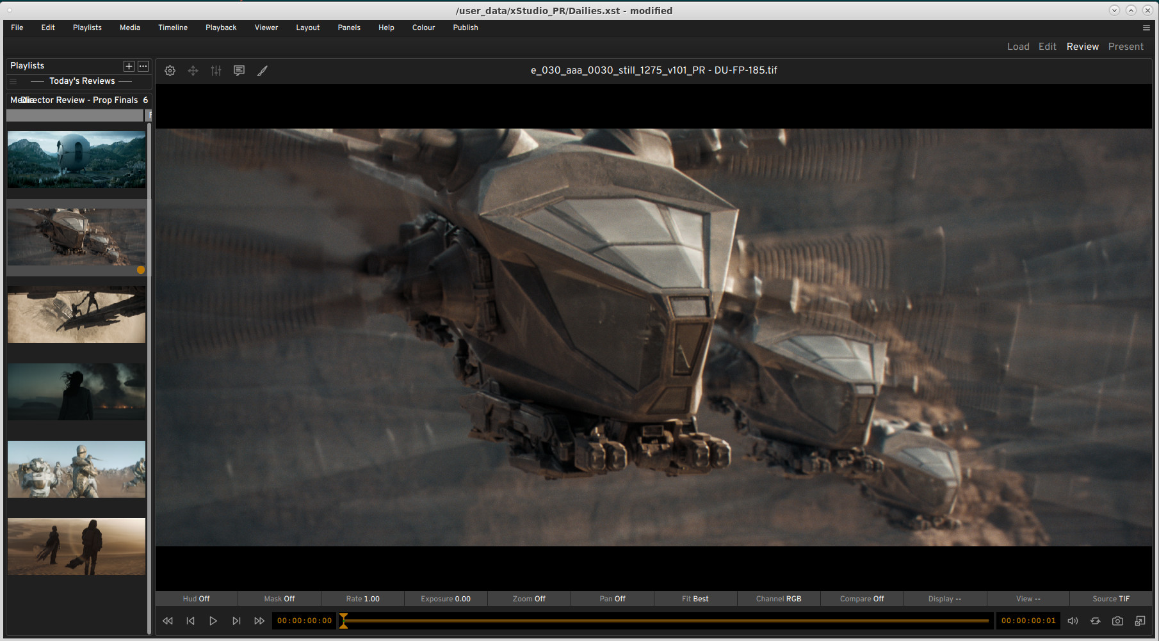
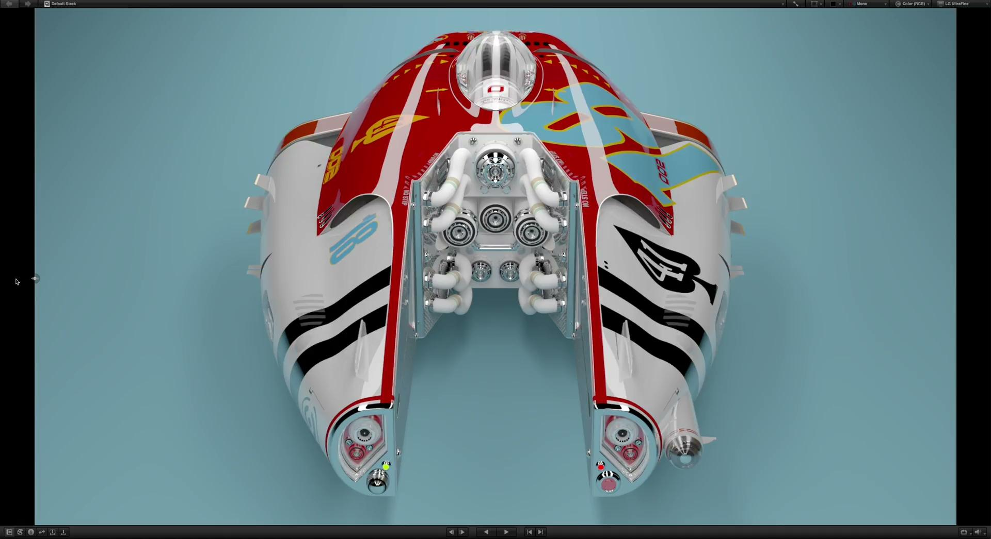
Autodesk’s RV Player
DNEG’s xSTUDIO
Open Review Initiative
A new open source project with the mission to build a unified toolset for playback, review and approval of motion picture and related professional media, with Autodesk contributing RV, Dneg contributing xSTUDIO, Imageworks contributing parts of itView, and the three companies providing lead architects and maintainers for the project Technical Steering Committee.
openreviewinitiative.org

Slide 30
Why host your project at the
Academy Software Foundation?

Slide 31
Question: Value of a Foundation?
There have been times when projects have asked what the value of an open source foundation can offer them?
A basic premise behind the LF, and open source in general, is that most interactions are positive-sum. There is no fixed amount of investment, mindshare, or development contributions that is allocated to specific projects. Just as open source development is based on the idea that, collectively, we are smarter than any one of us, open source foundations work to make the entire community better off. Equally important, a neutral home for a project and community fosters this type of positive-sum thinking and drives growth and diversity that we believe are core elements of a successful open source project.

Slide 32
It’s more than putting a project on GitHub
Organizations and projects come to the Academy Software Foundation to…
Have a vendor-neutral home for the project and assets.
Bring in contributors from different organizations ( including your competitors )
Drive broad industry awareness with press and analysts.
Build a downstream ecosystem for open and commercial solutions.
Have world-class tools for measuring project insights and success.
Leverage the collective experience and expertise of the Linux Foundation.
How does the Academy Software Foundation enable this?

Slide 33

Vendor-neutrality provides a sustainable home
Groundbreaking and game-changing projects are a collective effort across organizations. Hosting at the Academy Software Foundation ensures a project has a reputable legal home and governance to attract contributors and adoption.
All projects are set up as 501c6 Series LLC legal entities, giving the project a non-profit status and giving them the autonomy to set their own policies and processes with expert guidance.
Infrastructure such as mailing lists, websites, and domain names are owned by the project to ensure neutral management.
Academy Software Foundation TAC project lifecycle gives the project guidance on how to establish a sustainable project.

Slide 34

Bring in a broader contributor base
Shared R&D with a broad ecosystem means bringing more contributors and maintainers into your project - including your competitors.
Our staff works with the project to establish an open, neutral governance that makes roles clear and paths to leadership available.
All projects have a Code of Conduct to ensure collaboration is done in safe and welcoming environment for all.
Outreach done through the Academy Software Foundation is done from a neutral perspective, which separates out product promotion and vendor favoritism and promotes the work of the community.

Slide 35



Drive broad industry awareness with press and analysts
Through our large audience, extensive media outreach, and with key partnership with publications such as Linux.com and TFiR your project will get broad exposure in energy, tech, and open source.
Your project will be featured on both the Academy Software Foundation website and Linux Foundation website.
Always available guest blog post(s) on the Academy Software Foundation blog on project updates.
Post one technical article about an open source project you care about to Linux.com, which has over 1 million unique visitors per month.
Support of your announcements with social outreach and quotes from Linux Foundation and/or Academy Software Foundation leadership as appropriate.
Access to opportunities for contributed articles, videos, podcasts, and events
1800+
followers
1700+
followers

Slide 36

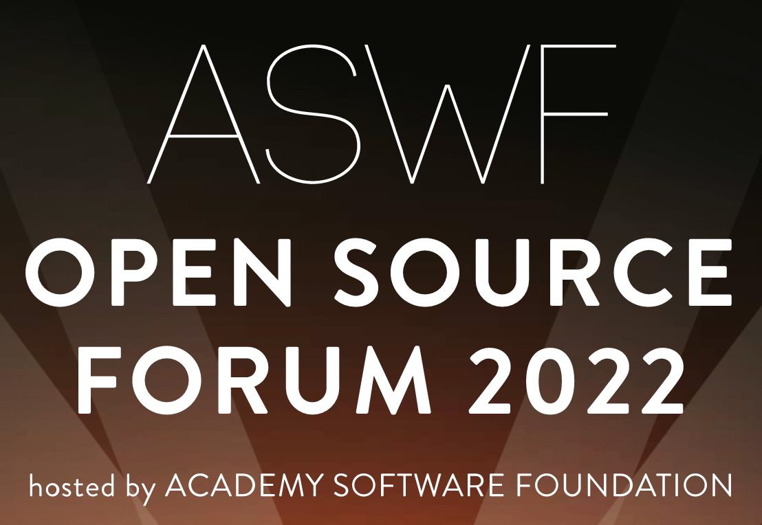
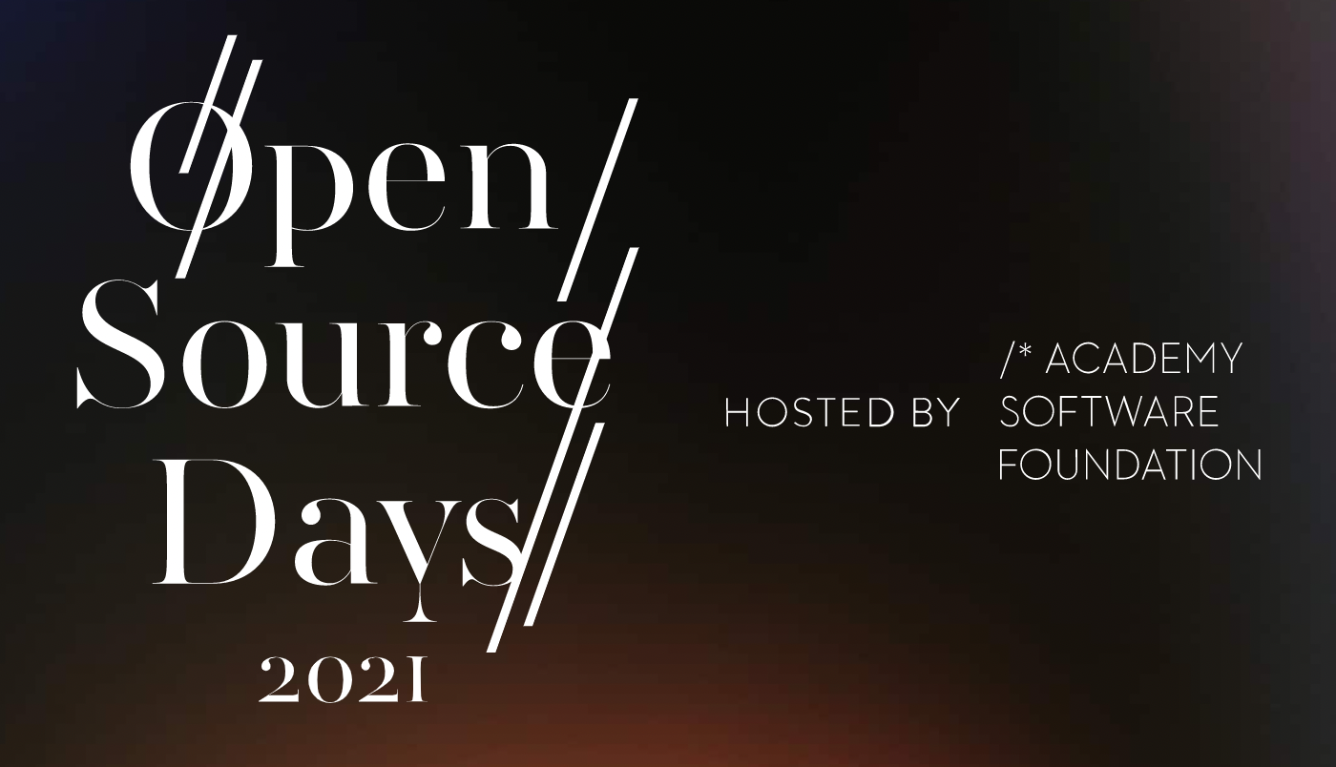
Build a downstream ecosystem for open and commercial solutions
Sustainable projects are those the industry adopts and drive economic value with. Doing this at Academy Software Foundation takes advantage of the expertise in building these programs.
Conformance programs with community requirements that are managed by the Academy Software Foundation Projects
Training and certification programs through LF Training
Badging using Credly to recognize individuals
Events for the community to connect and collaborate.

Slide 37
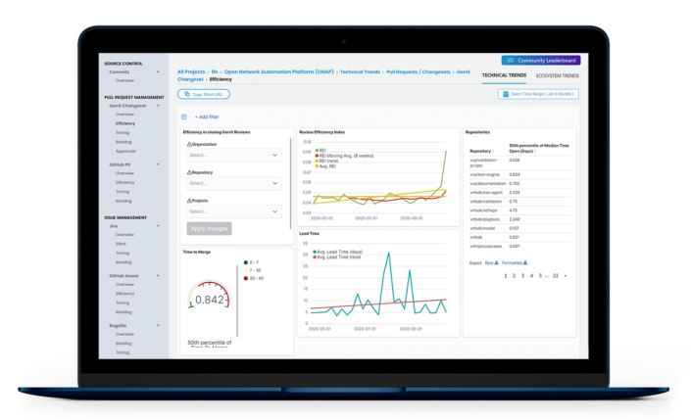


World class tools with LFX
LFX Insights is an analytics tool that is provided to all open source projects hosted by the Linux Foundation. Its capabilities include:
Getting the visibility you need to remove bottlenecks at any stage of your project’s code pipeline. Drill down into performance metrics across every step in the development lifecycle to identify where you should be focusing your resources.
Ensuring the health and viability of the open source projects you care about. Leverage data to help validate projects for investment, and track the activity and growth of projects your organization is already involved in.
Showcasing your organization’s leadership and subject matter expertise in the open source community. Leverage affiliations to measure the impact of your employees’ contributions and capture the full picture of your team’s impact
LFX Security is a tool for managing security for your project. It’s capabilities include:
Monitoring of your entire project for potential vulnerabilities with an aggregated project-level view of your entire software sandwich across source control systems and repositories, with the ability to remediate the found issues.
Identifying non-inclusive language and code secrets in your project to prevent embarrassing situations.

Slide 38
Leverage the collective experience and expertise of the Linux Foundation
Academy Software Foundation staff collective have decades of experience in driving open source projects and ecosystems in a variety of vertical and horizontal industries, bringing the best practices to your project
Press relations and analyst relations teams to increase awareness of and excitement about your project, and receive regular reports on press mentions and comparisons to similar projects.
Academy Software Foundation is able to leverage the expertise of its parent organization, The Linux Foundation, which hosts other successful projects including the Linux kernel, Let’s Encrypt, and Node.js.
You will have access to full-time Academy Software Foundation staff who are eager to assist your project in myriad ways and help make it successful

Slide 39
Bringing your project here

Slide 40
Anna Karenina Principle of Open Source
https://en.wikipedia.org/wiki/Anna_Karenina_principle
All happy open source projects are alike; each unhappy open source project is unhappy in its own way…
The “LF Way” is that there is no one way...
The LF assumes that each open source project is unhappy/different in its own way and that leads to building a unique governance and solution to sustain their communities...

Slide 41
Basic requirements for hosting a project at Academy Software Foundation
The project must:
use an approved OSI open source license;
be supported by a TAC member;
allow neutral ownership of project assets such as a trademark, domain or GitHub account (the community can define rules and manage them);
technical do-ocracy and separation of business governance from technical governance (we're flexible on the model) clearly documented in a charter;
allow anyone to participate in the technical community, whether or not a financial member or supporter of the project
Often projects are new open source project, but that isn’t a requirement - existing projects are welcome!

Slide 42
Project Preparation Checklist
Prepare draft mission and scope statement
Identify internal teams within mission and scope
Identify developers internally
Analyze code for identification of licenses, license quality and project dependencies
Assess potential universe of project participants
Identify ecosystem constituents and concerns of each
Identify any trademarks leveraged by the project (these will be owned by the LF neutrally)
Outline infrastructure, marketing any other requirements needed for the project
Complete the project proposal and submit to the TAC for consideration
The Academy Software Foundation staff is happy to engage and advise during this process - let us know how we can help!

Slide 43
Project Trademarks
Our project communities control the name of the project, not any one member or company contributor
In order to provide for neutral ownership of project assets, we require that The Linux Foundation entities own the trademarks leveraged by the project.
In the event that a trademark is already in use by the sponsoring organization, we recommend that the project create a new name to operate under or the owner assign the interest in the mark to The Linux Foundation.
See http://fossmarks.org for an education on trademarks in open source

Slide 44
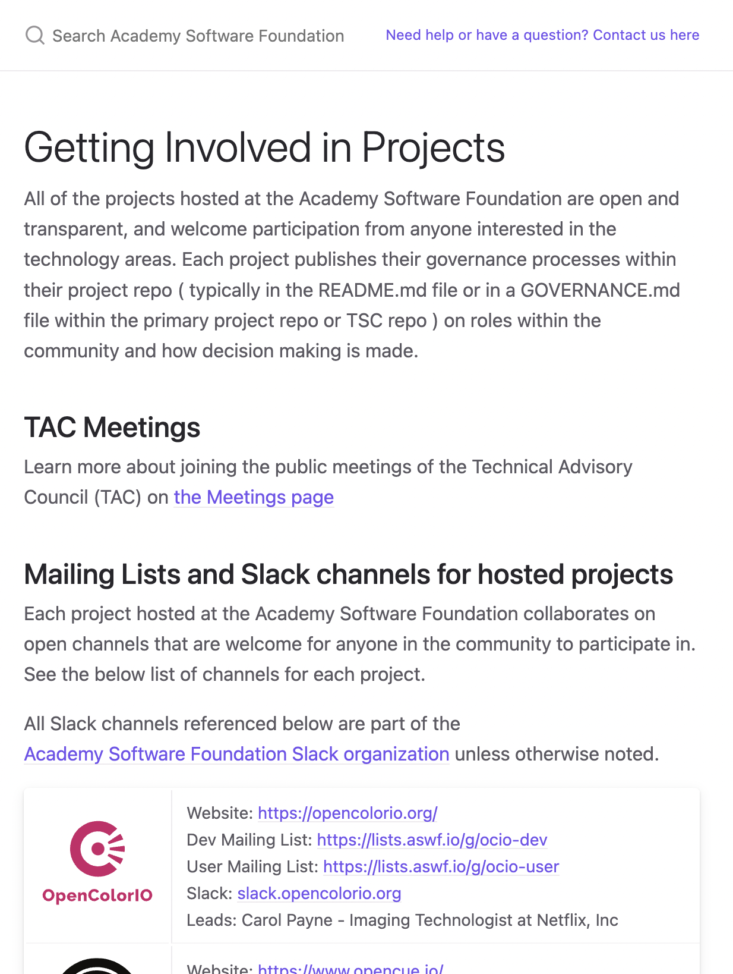
How to contribute
Contribute to an existing project:
Submit a PR with a bugfix or new feature
Pick existing GitHub issue as a sample project
Integrate with a new app / contribute plugin
Help improve project documentation
Submit additional test cases
Join the TSC discussion: dev mailing list, conf calls
Get involved with the TAC or Working Group:
DevOps / CI expertise always useful
Interest / expertise in security especially welcome
Join the TAC discussions: mailing list, conf calls, working groups
More information at tac.aswf.io/engagement

Slide 45
Join the Discussion
Mailing Lists for ASWF projects: lists.aswf.io
Join as a member: aswf.io/join
Slack: slack.aswf.io
Github: github.com/AcademySoftwareFoundation
Behind the Screens: bit.ly/BehindtheScreens
Twitter: @AcademySWF, #ASWF
YouTube: AcademySoftwareFoundation

Slide 46
How to participate
Developers can join our mailing lists to stay informed
about the code and our projects at lists.aswf.io.
Learn how your organization can support the Academy Software Foundation community at aswf.io/join.
Stay connected to us on Twitter at
@AcademySWF and #ASWF

Slide 47


